Slide 1
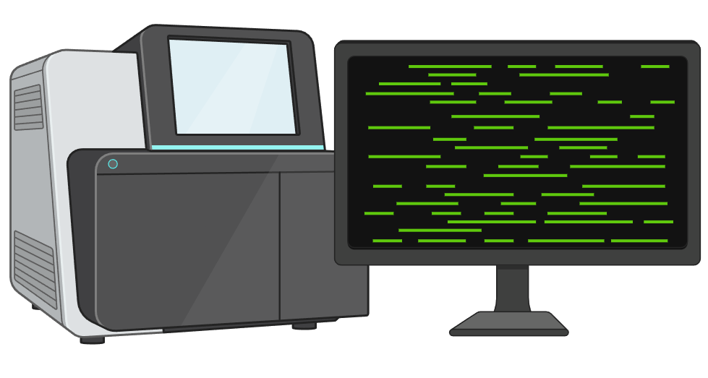
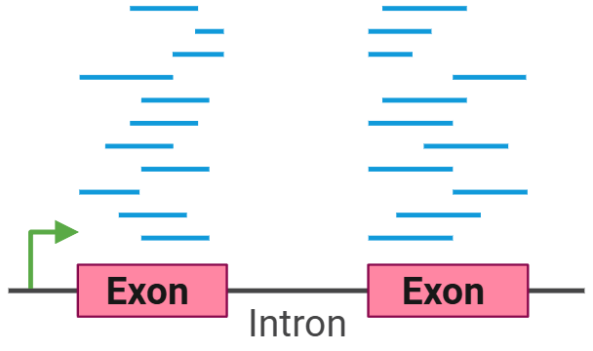
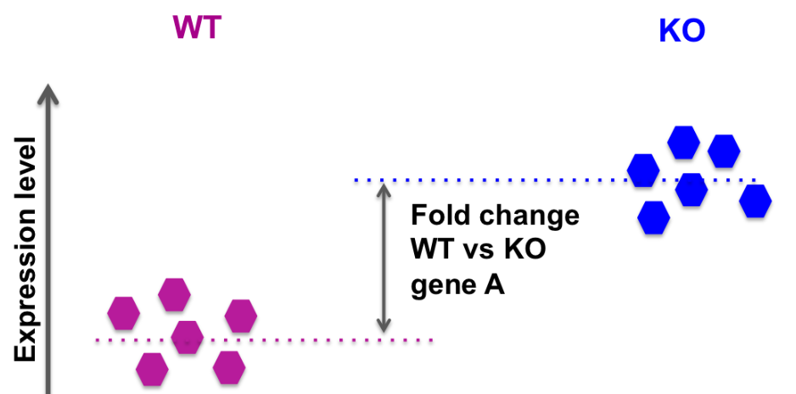

RNA sequencing
Millions of reads
2. Align to the genome.
Read counts per gene
(normalized to FPKM)
3. Fold change per gene
4. Publication
“In the MED4+1A3 co-culture, the only potential sign of stress was an increase in expression of two genes encoding putative antioxidants (thioredoxin-like and peroxiredoxin-like, see Table 2 and Supplementary Table S2 for detailed gene descriptions and PMT/PMM numbers not mentioned in the text). ”

Slide 2
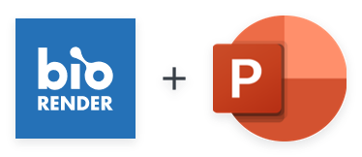

Get the BioRender Add-in for PowerPoint
Our integration allows you to unlock the power of BioRender, right inside PowerPoint:
  Export your BioRender presentation as an editable .PPTX file.
  Edit BioRender figures without leaving your PowerPoint slides.
  Sync updates from BioRender with just one click.
  Effortlessly manage sharing and permissions with your team.
  Access your entire BioRender library at your fingertips.
  Need a transparent background? Toggle it on or off, anytime.
BioRender for PowerPoint is hosted safely and securely in the Microsoft AppSource.
This presentation was created in BioRender
To access the original source of this presentation, visit:
https://app.biorender.com/illustrations/6990990c19ee8e0c6ece7d97
Sign up for your own BioRender account at www.biorender.com
Get the add-in now:
https://appsource.microsoft.com/en-us/product/office/wa200006038?src=product&mktcmpid=pptx_export

